Slide 1


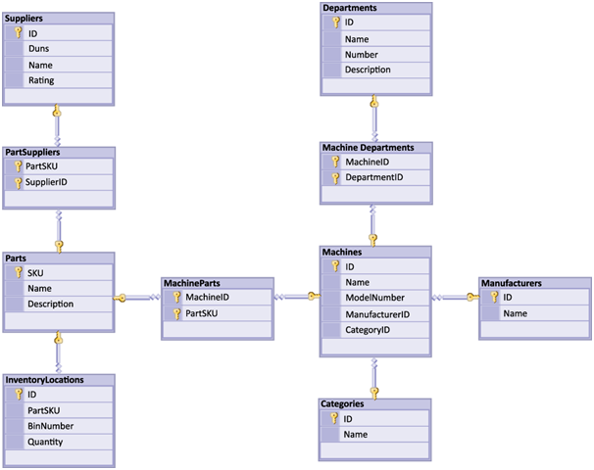


Table Relations
Database Design and Rules
Table
Relations
SoftUni Team
Technical Trainers
Software University
http://softuni.bg

Slide 2
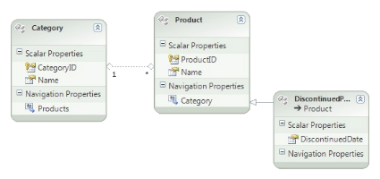




Table of Content
Database Design
Table Relations
Cascade Operations
E/R Diagrams

Slide 3
Questions
sli.do #CSharpDB

Slide 4

Database Design
Fundamental Concepts

Slide 5

Steps in Database Design
Steps in the database design process:
Identify entities
Identify table columns
Define a primary key for each table
Identify and model relationships
Multiplicity of relationships
Define other constraints
Fill tables with test data

Slide 6
DB Design: Identify Entities
Entity tables represent objects from the real world
Most often they are nouns in the specification
For example:
Entities: Student, Course, Town
We need to develop a system that stores information about students, which are trained in various courses. The courses are held in different towns. When registering a new student the following information is entered: name, faculty number, photo and date.

Slide 7
DB Design: Identify Table Columns
Columns are clarifications for the entities in the text of the specification, for example:
Students have the following characteristics:
Name, faculty number, photo, date of enlistment and a list of courses they visit
We need to develop a system that stores information about students, which are trained in various courses. The courses are held in different towns. When registering a new student the following information is entered: name, faculty number, photo and date.

Slide 8
How to Choose a Primary Key?
Always define an additional column for the primary key
Don't use an existing column (for example SSN)
Must be an integer number
Must be declared as a primary key
Use IDENTITY to implement auto-increment
Put the primary key as a first column
Exceptions
Entities that have well known ID, e.g. countries (BG, DE, US) and currencies (USD, EUR, BGN)

Slide 9
DB Design: Identify Entity Relationships
Relationships are dependencies between the entities:
"Students are trained in courses" ➔ many-to-many relationship
"Courses are held in towns" ➔ many-to-one (or many-to-many) relationship
We need to develop a system that stores information about students, which are trained in various courses. The courses are held in different towns. When registering a new student the following information is entered: name, faculty number, photo and date.

Slide 10



Table Relations
Relational Database Model in Action

Slide 11
Table Relations
Relationships between tables are based on interconnections: primary key ➔ foreign key
Primary key
Foreign key
Towns
Primary key
Countries
Id | Name | CountryId
1 | Sofia | 1
2 | Varna | 1
3 | Munich | 2
4 | Berlin | 2
5 | Moscow | 3
Id | Name
1 | Bulgaria
2 | Germany
3 | Russia
Relationship

Slide 12
Table Relations: Foreign Key
The foreign key is an identifier of a record located in another table (usually a primary key)
Using relationships, we refer to data instead of repeating data
Country name is not repeated, it is referred to by its primary key
Towns
Countries
Id | Name | CountryId
1 | Sofia | 1
2 | Varna | 1
3 | Munich | 2
4 | Berlin | 2
Id | Name
1 | Bulgaria
2 | Germany

Slide 13
Table Relations: Multiplicity
One-to-many – e.g. country / towns
One country has many towns
Many-to-many – e.g. student / course
One student has many courses
One course has many students
One-to-one – e.g. example driver / car
One driver has only one car
Rarely used

Slide 14
One-to-Many/Many-to-One
Primary key
Foreign key
Primary key
Mountains
Peaks
MountainID | Name
5 | Rila
PeakID | Name | MountainID
61 | Musala | 5
66 | Malyovitsa | 5
Relation
Notes:
One-to-Many relationship means that each row from a table is related zero, one or many rows in the referent table. In the case above, each mountain can have 0, 1 or many peaks. The example shows that the mountain Caucasus has two peaks - One-to-Many. If you look the other way around many peaks has exactly one mountain – Many-to-One.

Slide 15
One-to-Many: Tables
Primary key
CREATE TABLE Mountains(
MountainID INT PRIMARY KEY,
MountainName VARCHAR(50)
)
CREATE TABLE Peaks(
PeakId INT PRIMARY KEY,
MountainID INT,
CONSTRAINT FK_Peaks_Mountains
FOREIGN KEY (MountainID) REFERENCES Mountains(MountainID) )
Foreign Key

Slide 16
One-to-Many: Foreign Key
The table holding the foreign key is the child table
The table holding the referenced primary key is the parent/referenced table
Constraint Name
CONSTRAINT FK_Peaks_Mountains FOREIGN KEY (MountainID) REFERENCES Mountains(MountainID)
Foreign Key
Parent Table
Primary Key

Slide 17
Many-to-Many
Many-to-many relations use a mapping/join table
Primary key
Primary key
Employees
Projects
EmployeeID | EmployeeName
1 | …
40 | …
ProjectID | ProjectName
4 | ..
24 | …
EmployeesProjects
Mapping table
EmployeeID | ProjectID
1 | 4
1 | 24
40 | 24
Notes:
Many-to-Many relationship relates many rows from a table to many rows in another table. For example. Employee.EmployeeID has many projects. Many projects are assigned to many employees which is the other way around. Usually we have a mapping table that takes care of the relations.

Slide 18
Many-to-Many: Tables
CREATE TABLE Employees(
EmployeeID INT PRIMARY KEY, EmployeeName VARCHAR(50)
)
CREATE TABLE Projects( ProjectID INT PRIMARY KEY, ProjectName VARCHAR(50)
)

Slide 19
Many-to-Many: Mapping Table
CREATE TABLE EmployeesProjects( EmployeeID INT, ProjectID INT,
CONSTRAINT PK_EmployeesProjects
PRIMARY KEY(EmployeeID, ProjectID),
CONSTRAINT FK_EmployeesProjects_Employees
FOREIGN KEY(EmployeeID)
REFERENCES Employees(EmployeeID),
CONSTRAINT FK_EmployeesProjects_Projects
FOREIGN KEY(ProjectID)
REFERENCES Projects(ProjectID)
)
Composite Primary Key
Foreign Key to Employees
Foreign Key to Projects

Slide 20
One-to-One
Primary key
Primary key
Foreign key
Cars
Drivers
CarID | DriverID
1 | 166
2 | 102
DriverID | DriverName
166 | ..
102 | …
Relation
Notes:
In One-to-One relationship each row of table Cars is related to exactly zero or one row in table Drivers. In table Cars.DriverID is a foreign key which means that there will be a relation to another table – Drivers in the case. Table Drivers has a column DriverID as well which is a primary key. The relation is always between a foreign key and a primary key. It means that all values in Cars.DriverID should be present in Drivers. DriverID except NULL. Cars.DriverID can be NULL if it is not stated otherwise.

Slide 21
One-to-One
Primary key
CREATE TABLE Drivers(
DriverID INT PRIMARY KEY,
DriverName VARCHAR(50)
)
CREATE TABLE Cars(
CarID INT PRIMARY KEY,
DriverID INT UNIQUE,
CONSTRAINT FK_Cars_Drivers FOREIGN KEY (DriverID) REFERENCES Drivers(DriverID)
)
One driver
per car
Foreign Key

Slide 22
One-to-One: Foreign Key
Constraint Name
CONSTRAINT FK_Cars_Drivers FOREIGN KEY (DriverID) REFERENCES Drivers(DriverID)
Foreign Key
Referenced Table
Primary Key

Slide 23
Retrieving Related Data
Towns
Countries
Using Simple JOIN statements

Slide 24
JOIN Statements
With a JOIN statement, we can get data from two tables simultaneously
JOINs require at least two tables and a "join condition"
SELECT * FROM Towns
JOIN Countries ON
Countries.Id = Towns.CountryId
Join Condition

Slide 25

Problem: Peaks in Rila
Use database "Geography". Report all peaks for "Rila" mountain.
Report includes mountain's name, peak's name and also peak's elevation.
Peaks should be sorted by elevation descending.
Check your solution here: https://judge.softuni.bg/Contests/Practice/Index/292#6

Slide 26
Solution: Peaks in Rila
Cross Table Selection
SELECT m.MountainRange, p.PeakName, p.Elevation
FROM Mountains AS m
JOIN Peaks As p ON p.MountainId = m.Id
WHERE m.MountainRange = 'Rila'
ORDER BY p.Elevation DESC
Join Condition
Check your solution here: https://judge.softuni.bg/Contests/Practice/Index/292#6

Slide 27

Cascade Operations
Cascade Delete/Update

Slide 28
Definition
Cascading allows when a change is made to certain entity, this change to apply to all related entities.
Primary key
Foreign key
Primary key
Orders
OrderItems
OrderID | OrderName
1 | …
22 | …
ItemId | OrderId
4 | 1
24 | 22
87 | 1
Cascade delete

Slide 29
Cascade Delete
Cascade can be either Delete or Update.
Use Cascade Delete when:
The related entities are meaningless without the "main" one
Do not use Cascade Delete when:
You perform a “logical delete“
Entities are marked as deleted (but not actually deleted)
In more complicated relations, cascade delete won't work with circular references

Slide 30
Cascade Update
Use Cascade Update when:
The primary key is not identity (not auto-increment) and therefore it can be changed
Best used with unique constraint
Do not use Cascade Update when:
The primary is identity (auto-increment)
Cascading can be avoided using triggers or procedures.

Slide 31
Cascade Delete: Example
CREATE TABLE Drivers(
DriverID INT PRIMARY KEY,
DriverName VARCHAR(50)
)
CREATE TABLE Cars(
CarID INT PRIMARY KEY,
DriverID INT,
CONSTRAINT FK_Car_Driver FOREIGN KEY(DriverID)
REFERENCES Drivers(DriverID) ON DELETE CASCADE )
Foreign Key
Cascade

Slide 32
Cascade Update: Example
CREATE TABLE Products(
BarcodeId INT PRIMARY KEY,
Name VARCHAR(50)
)
CREATE TABLE Stock(
Id INT PRIMARY KEY,
Barcode INT,
CONSTRAINT FK_Stock_Products FOREIGN KEY(BarcodeId)
REFERENCES Products(BarcodeId) ON UPDATE CASCADE )
Foreign Key
Cascade

Slide 33
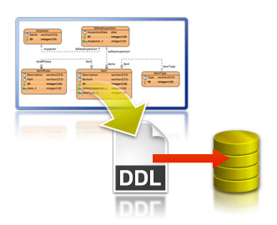
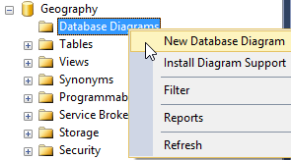
E/R Diagrams
Entity / Relationship Diagrams
Notes:
E/R diagrams represent the tables which are called entities and the relationships between them. They are used as a technical illustration of the database design.
To Do: snip how to create e/r diagram.

Slide 34
Relational Schema
Relational schema of a DB is the collection of:
The schemas of all tables
Relationships between the tables
Any other database objects (e.g. constraints)
The relational schema describes the structure of the database
Doesn't contain data, but metadata
Relational schemas are graphically displayed in Entity / Relationship diagrams (E/R Diagrams)

Slide 35
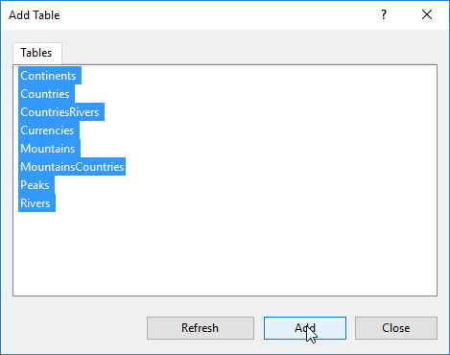
SSMS E/R Diagram: Usage
Expand a database in Object Explorer
Right click "Database Diagrams" then select "New Database Diagram"

Slide 36
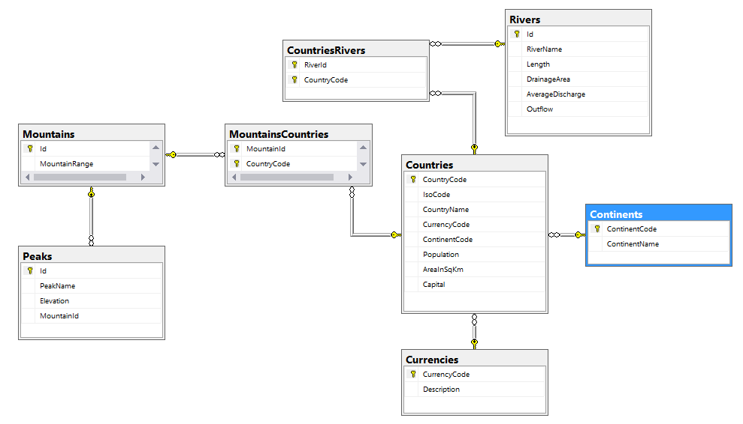
SSMS E/R Diagram

Slide 37


Summary
How to design multiple tables with related data?
What are the types of table relations?
Cascading – pros and cons?
How can we visualize all of our relations in a database?
Databases

Slide 38







Table Relations
https://softuni.bg/courses/databases-basics-ms-sql-server

Slide 39






SoftUni Diamond Partners

Slide 40






SoftUni Diamond Partners

Slide 41
License
This course (slides, examples, demos, videos, homework, etc.) is licensed under the "Creative Commons Attribution-NonCommercial-ShareAlike 4.0 International" license
Attribution: this work may contain portions from
"Databases" course by Telerik Academy under CC-BY-NC-SA license

Slide 42





Trainings @ Software University (SoftUni)
Software University – High-Quality Education, Profession and Job for Software Developers
softuni.bg
Software University Foundation
http://softuni.foundation/
Software University @ Facebook
facebook.com/SoftwareUniversity
Software University Forums
forum.softuni.bg

